Slide 1
Christmas in Poland
by Sara Kubiak

Slide 2
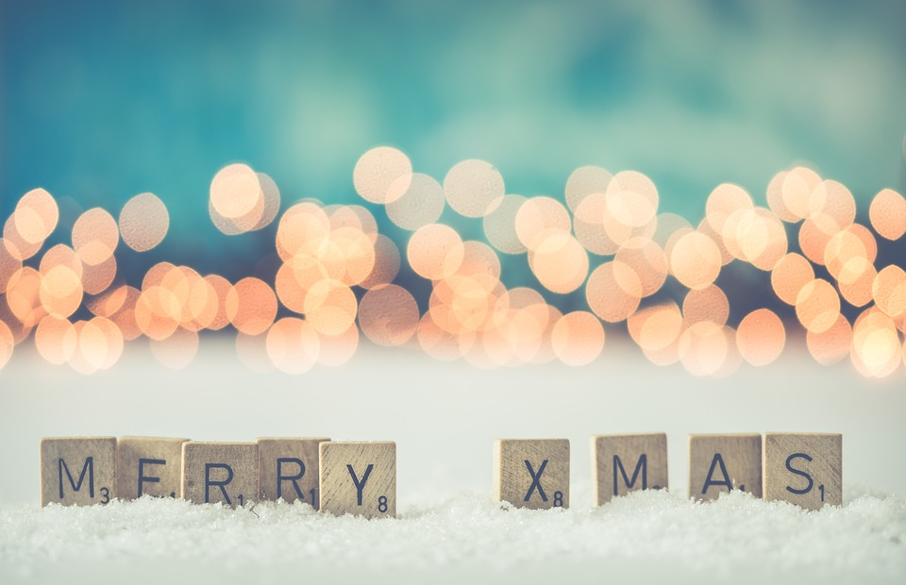
Christmas Eve
As in Poland, Christmas Eve is celebrated in Lithuania, the Czech Republic and Slovakia, often with borrowings from the Old Slavic holiday of God. The custom of breaking the wafer is unknown outside of Poland and Lithuania. In many countries there is no fasting or a Shepherd’s mass (Midnight Mass).

Slide 3
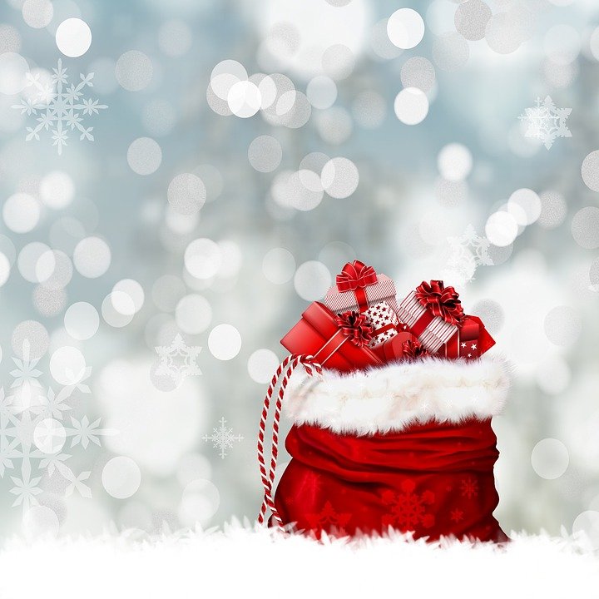
Christmas symbols

Slide 4
First star
It is a symbol of the Bethlehem Star whose appearance accompanied the birth of Jesus. Thanks to it shepherds, the Three Kings were able to reach the birthplace of the Savior. Today, we expect the first star to appear on the Christmas Eve sky. Only when it shines we can, according to tradition, sit at the table and share the wafer.

Slide 5
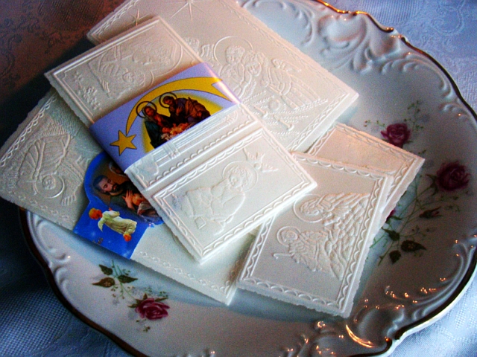
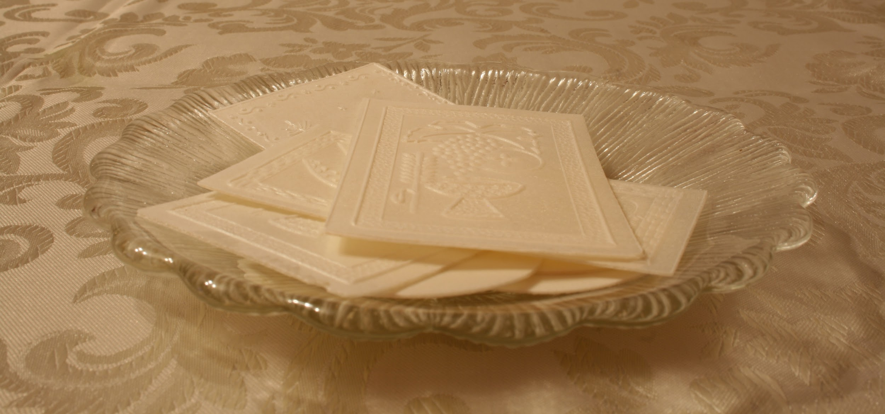
Wafer
The breaking of the Christmas wafer is a custom that began in Poland in the 10th century and is practiced by people of Polish ancestry around the world.
The Christmas wafer symbolizes the unity of the family, which many consider to be the main pillar of society. The bond of unity should exist between family members. The wafer also symbolizes forgiveness and reconciliation.

Slide 6
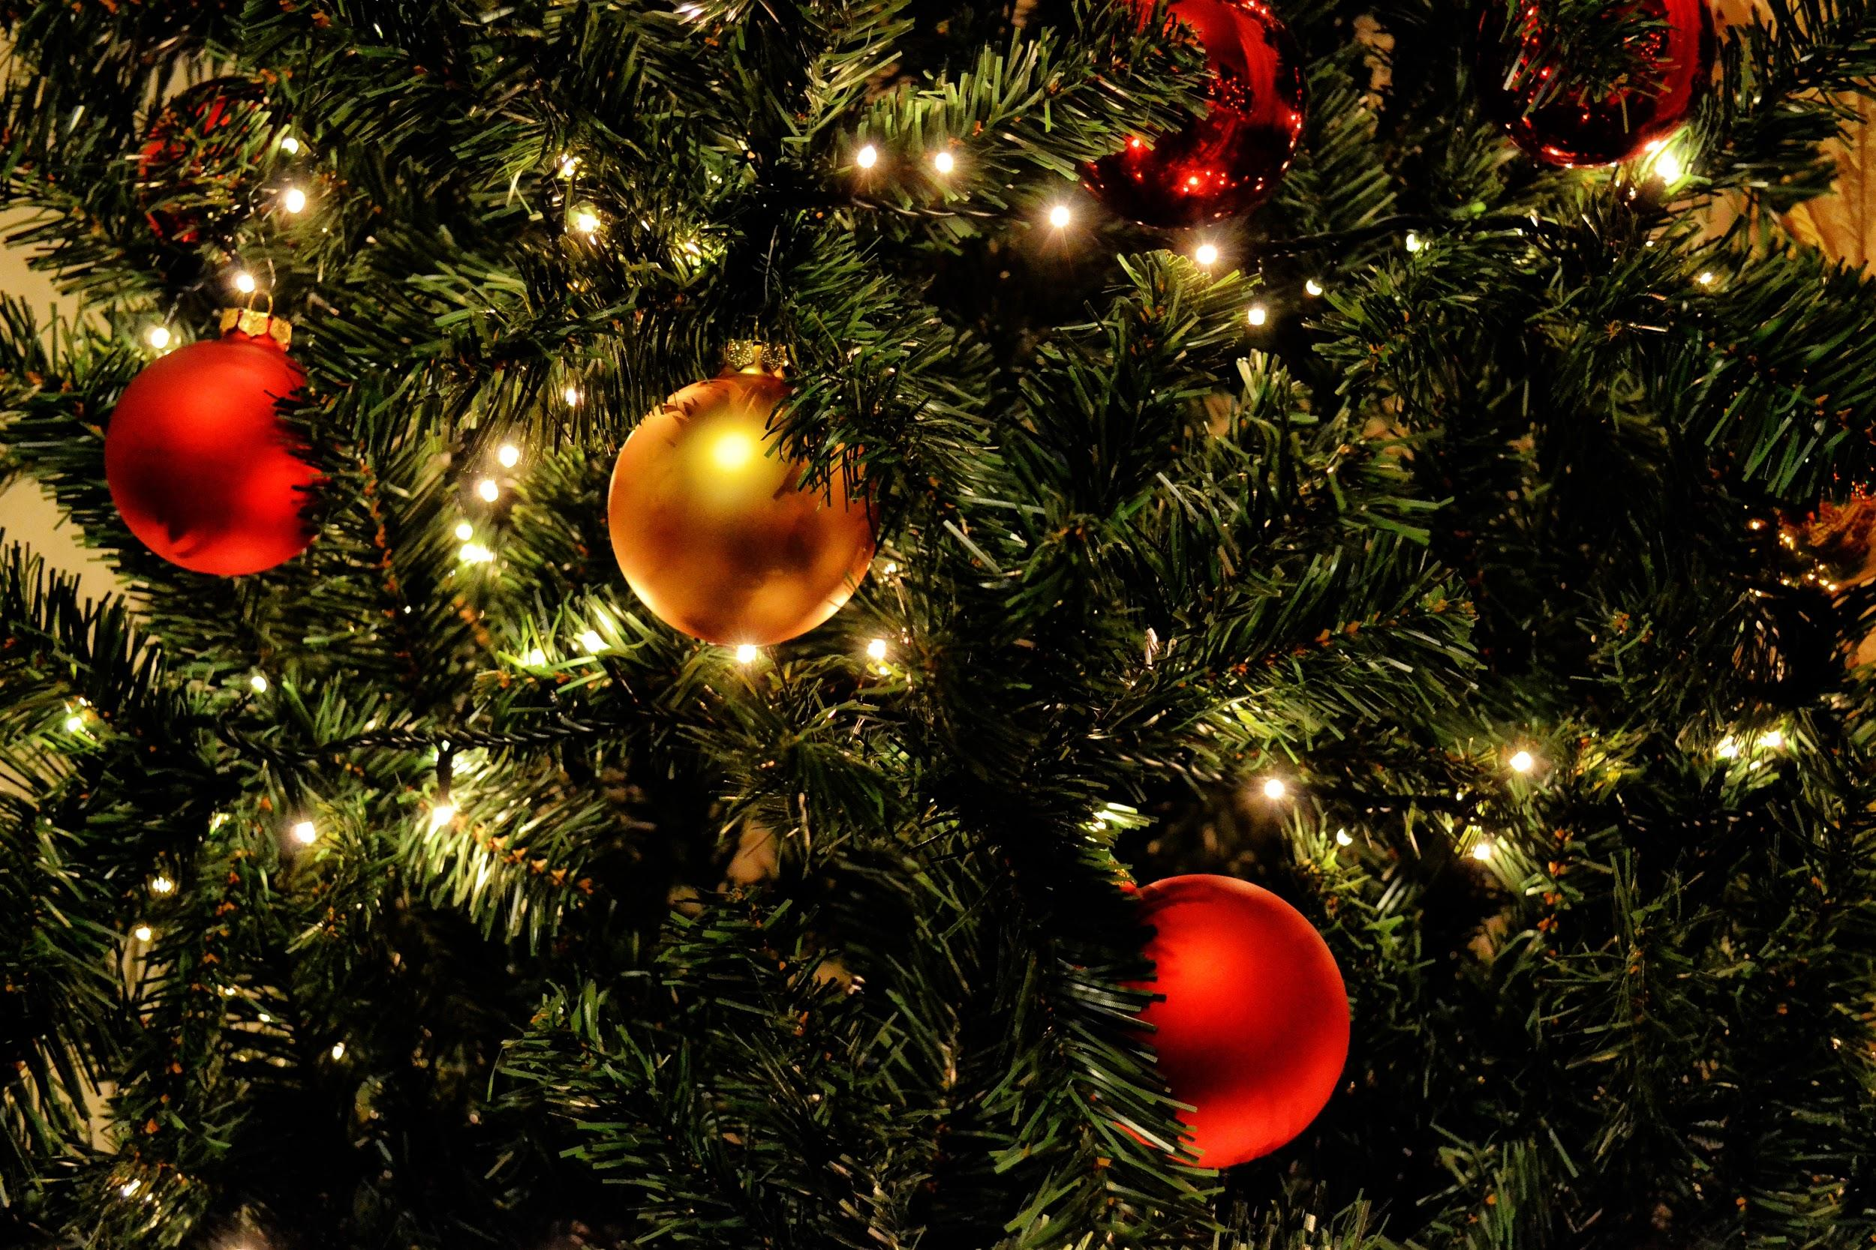
Christmas tree
A Christmas tree is usually an evergreen conifer such as spruce or pine. The custom was developed in medieval Livonia and in Germany.The tree was traditionally decorated with "roses made of colored paper, apples, wafers, sweetmeats". In the 18th century, it began to be illuminated by candles, which were ultimately replaced by Christmas lights. Today, there is a wide variety of traditional ornaments, such as garlands, baubles and candy canes. An angel or star might be placed at the top of the tree to represent the Angel Gabriel or the Star of Bethlehem, respectively, from the Nativity. Edible items such as gingerbread, chocolate and other sweets are also popular.

Slide 7
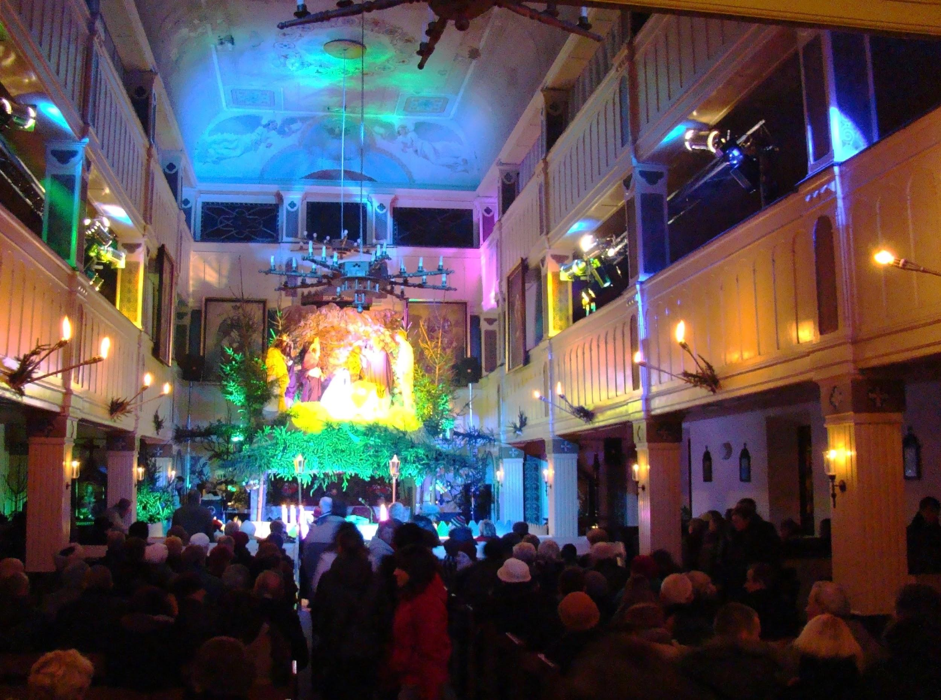
On Christmas eve at midnight
people attend a special mass.

Slide 8
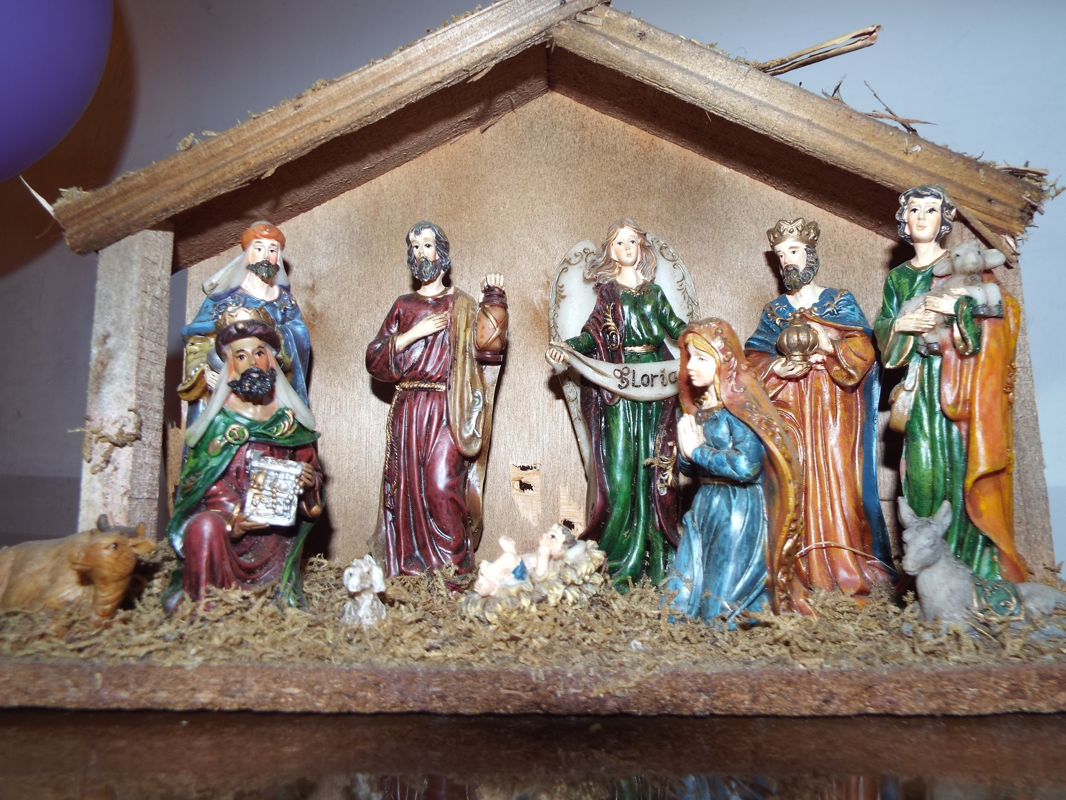
Stable
Jesus was born in the stable. It is also a symbol of ourselves. We are like a stable which it is not always pure, in which good interweaves with evil.

Slide 9
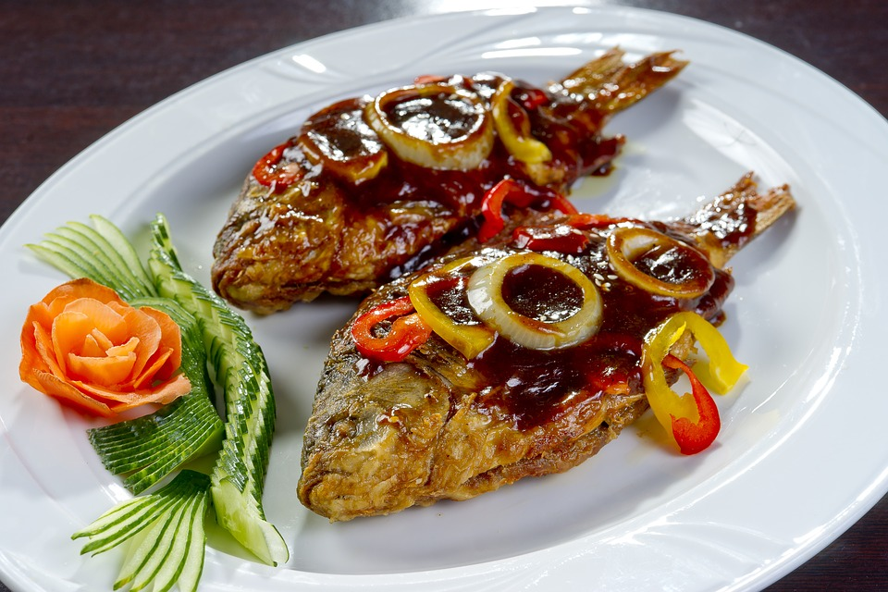
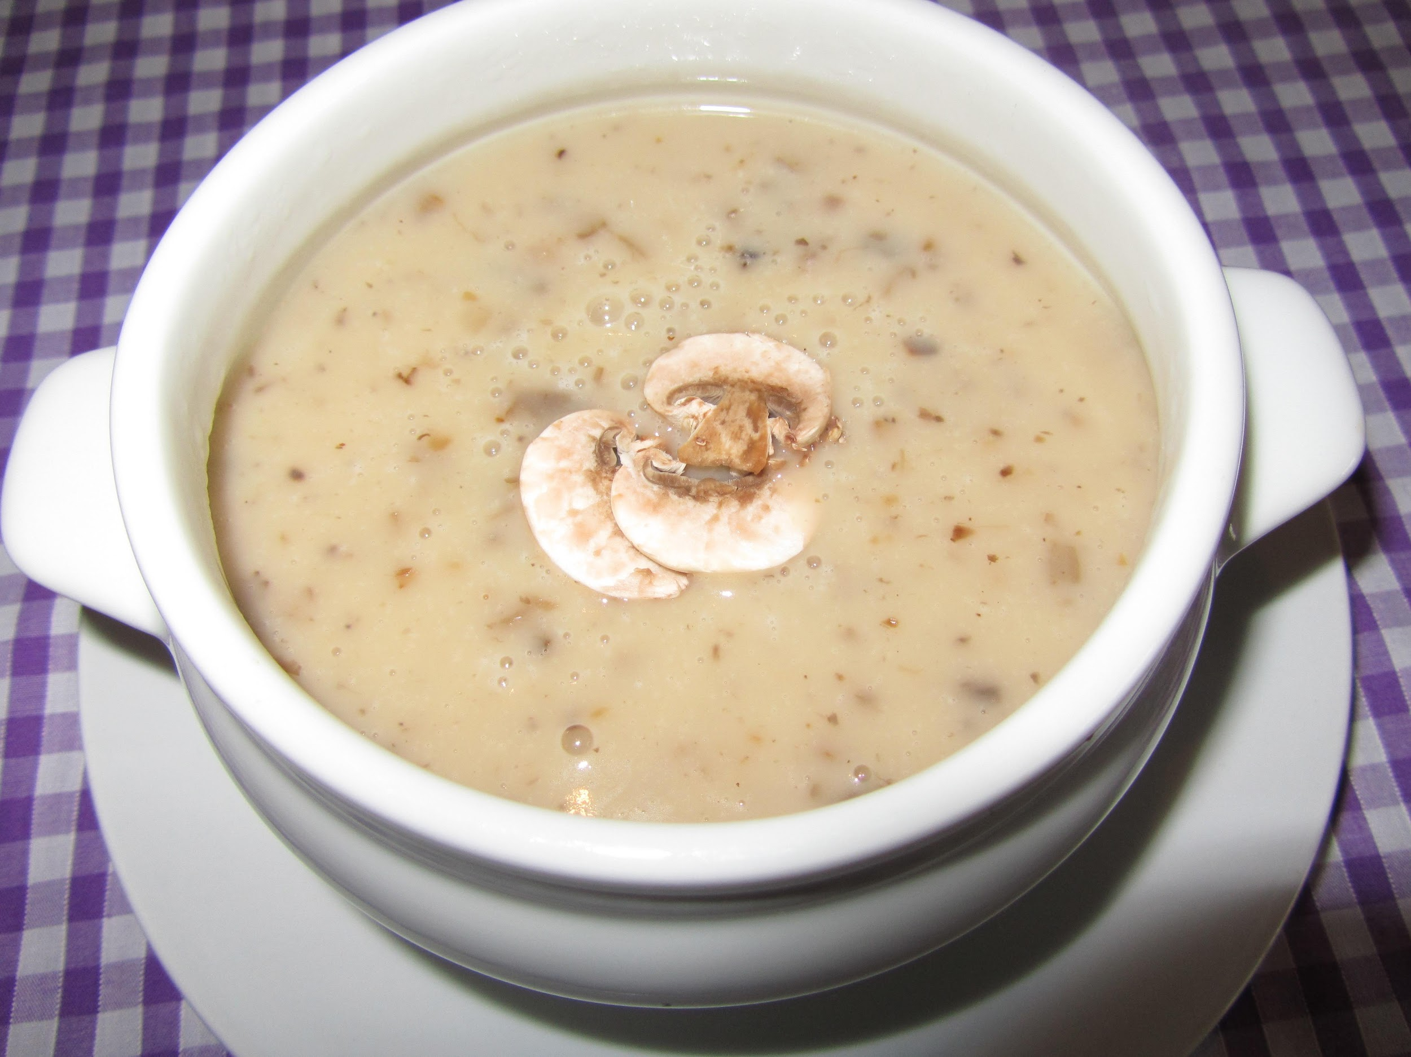
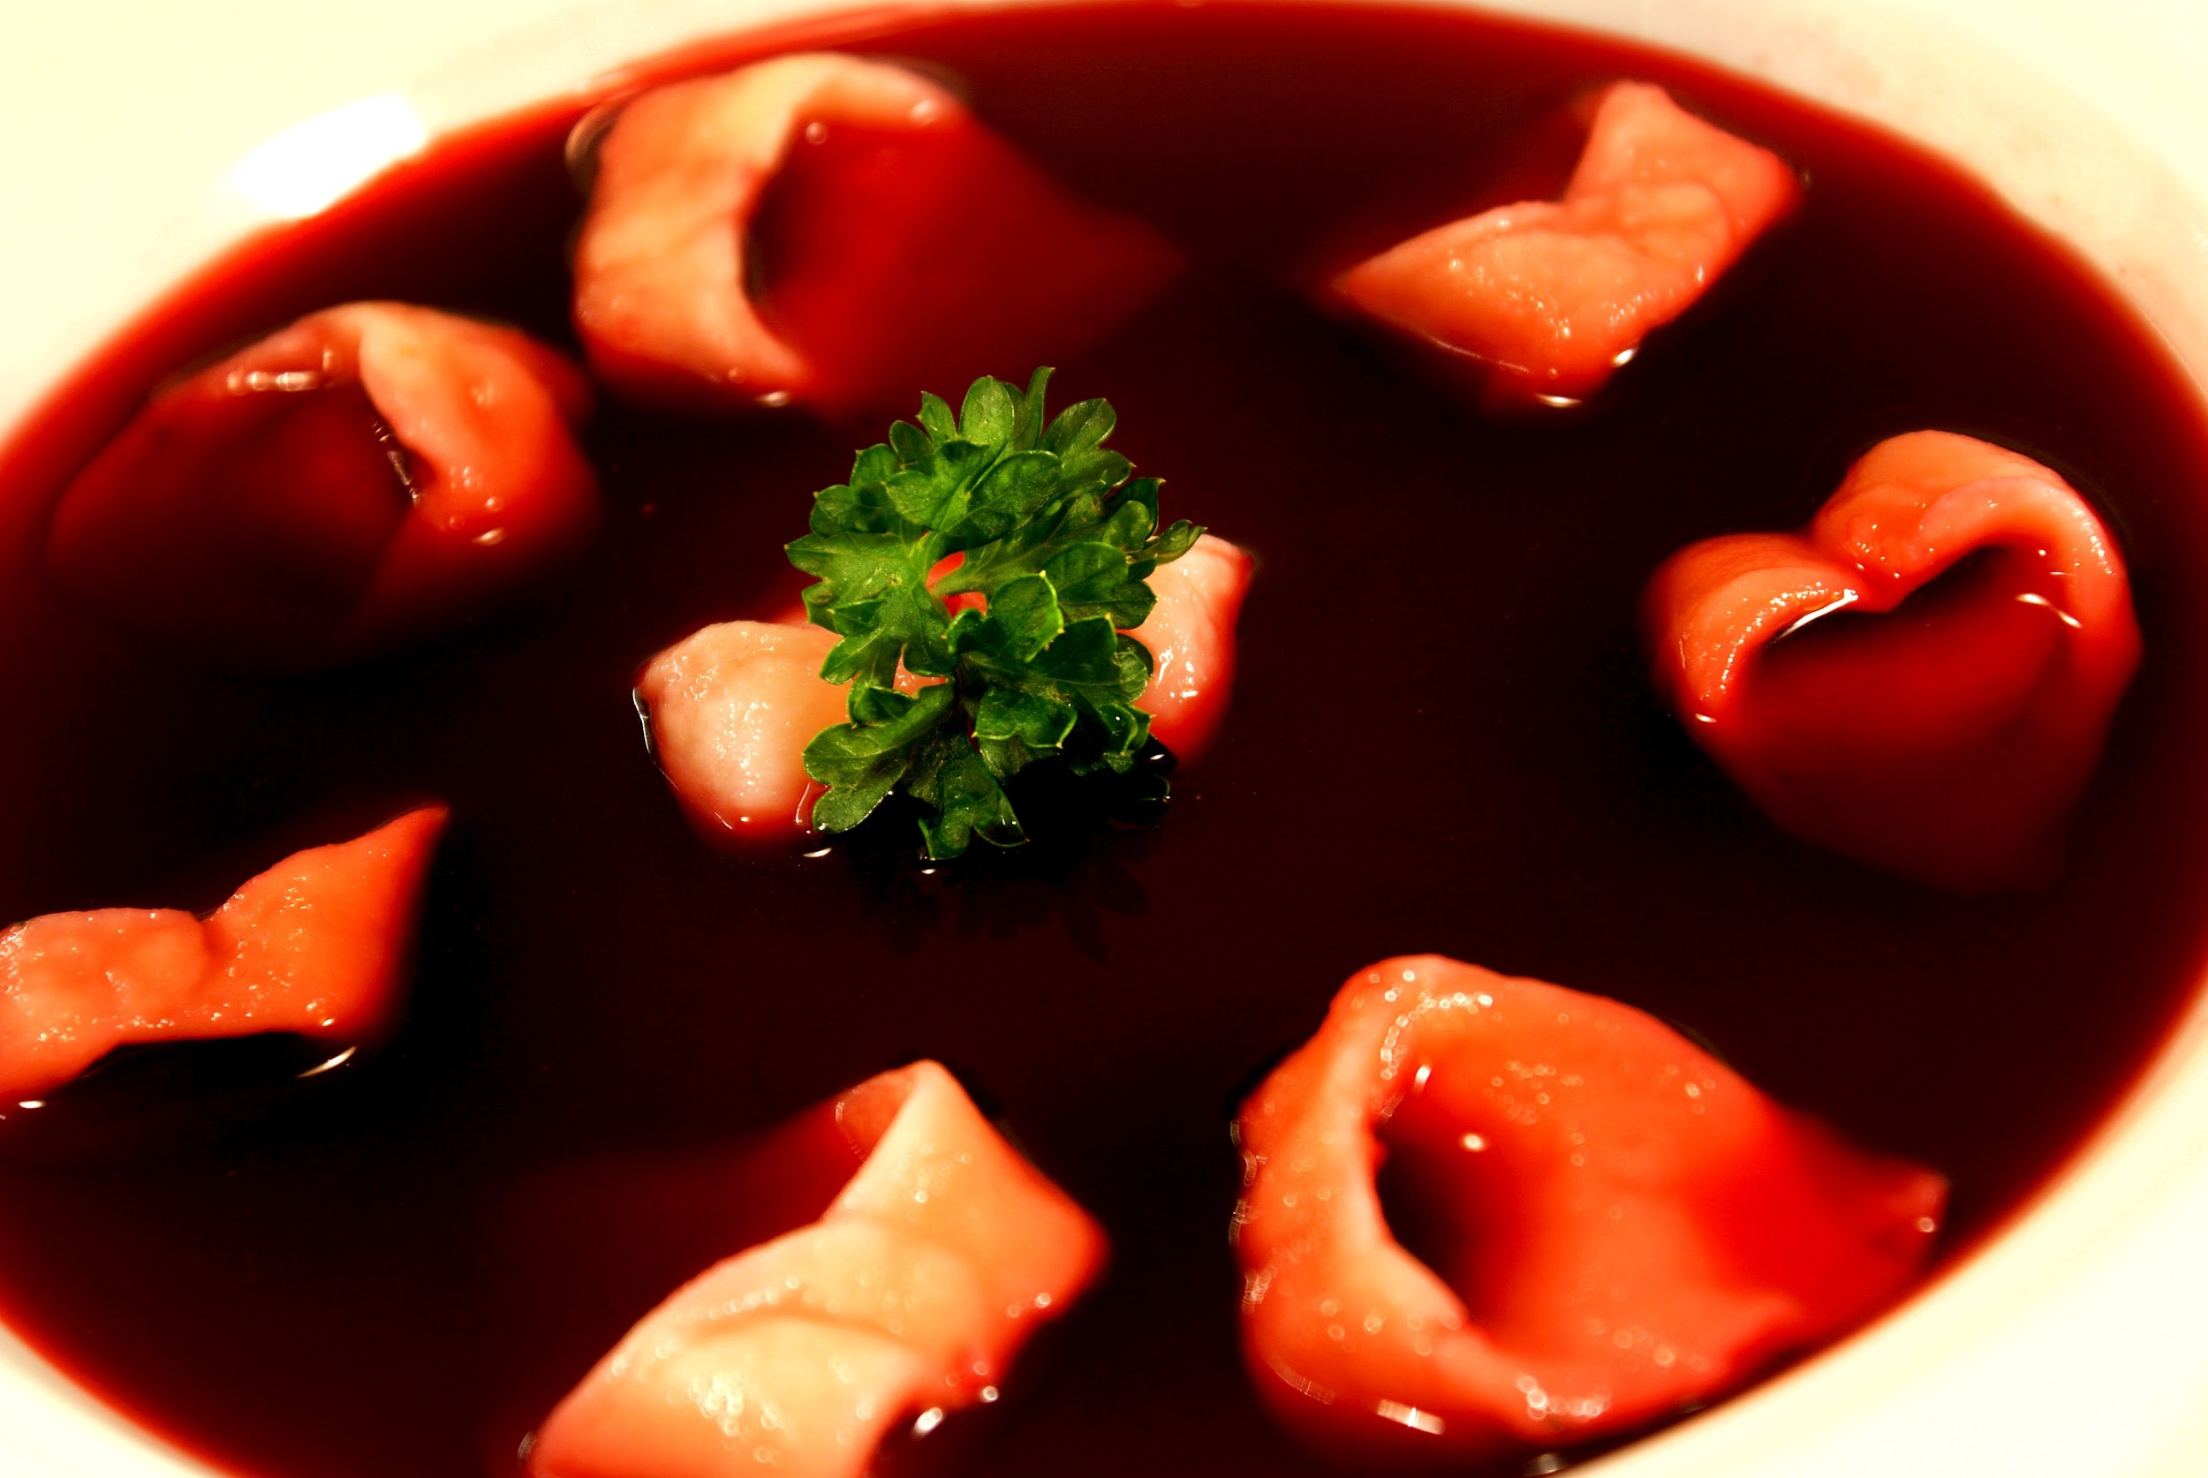
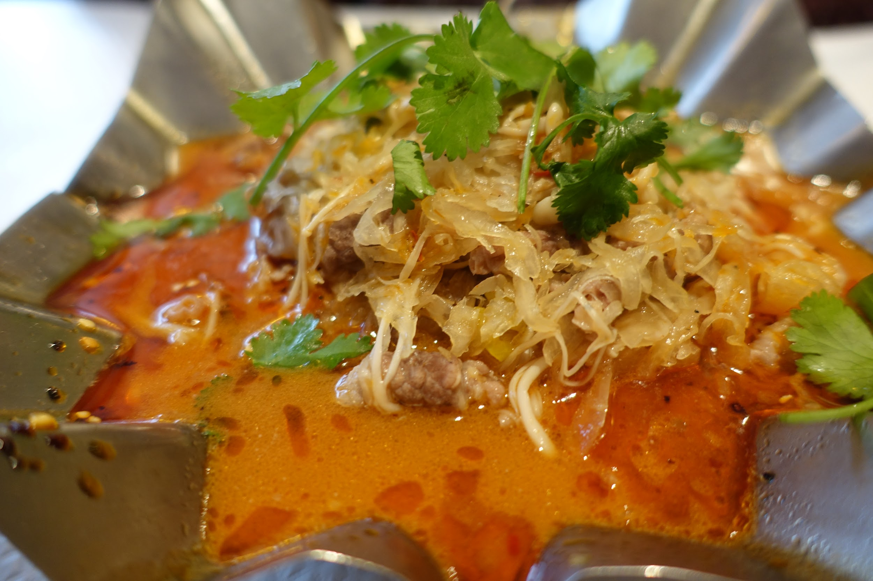
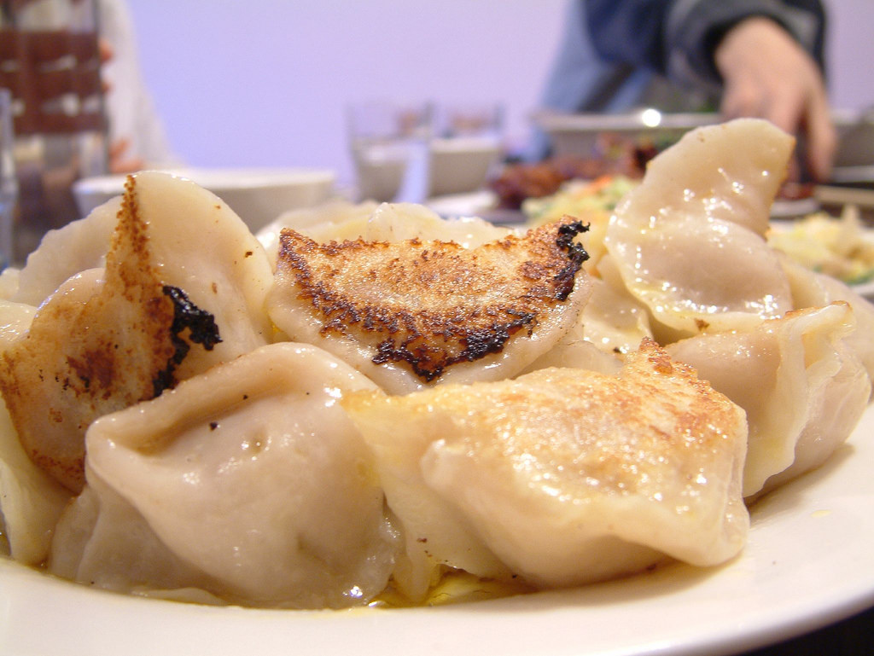
12 traditional Christmas Eve dishes
1. Mushroom soup 2. Borscht with dumplings 3. Carp, in various ways: - fried carp - Jewish carp - roasted carp - carp in jelly - fish soup with carp
4. Cabbage with mushrooms or cabbage with peas
5. Dumplings with cabbage and mushrooms

Slide 10
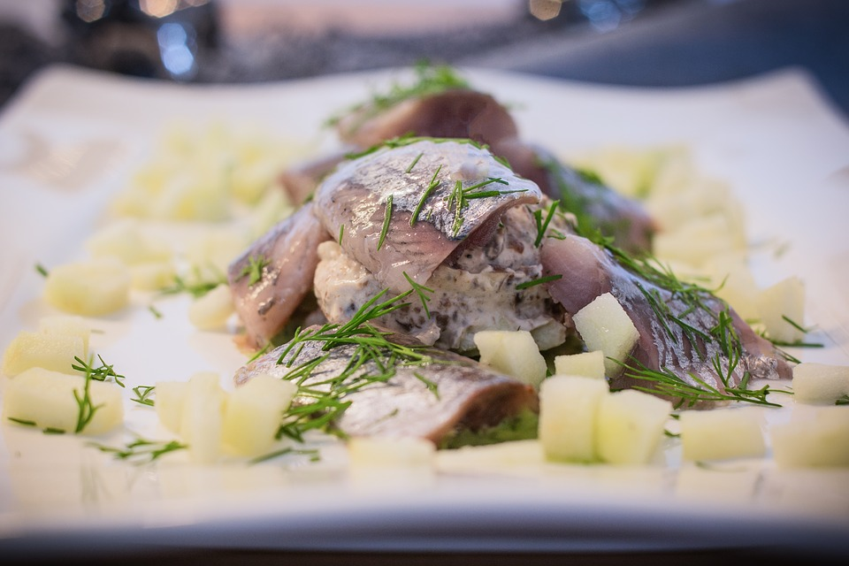
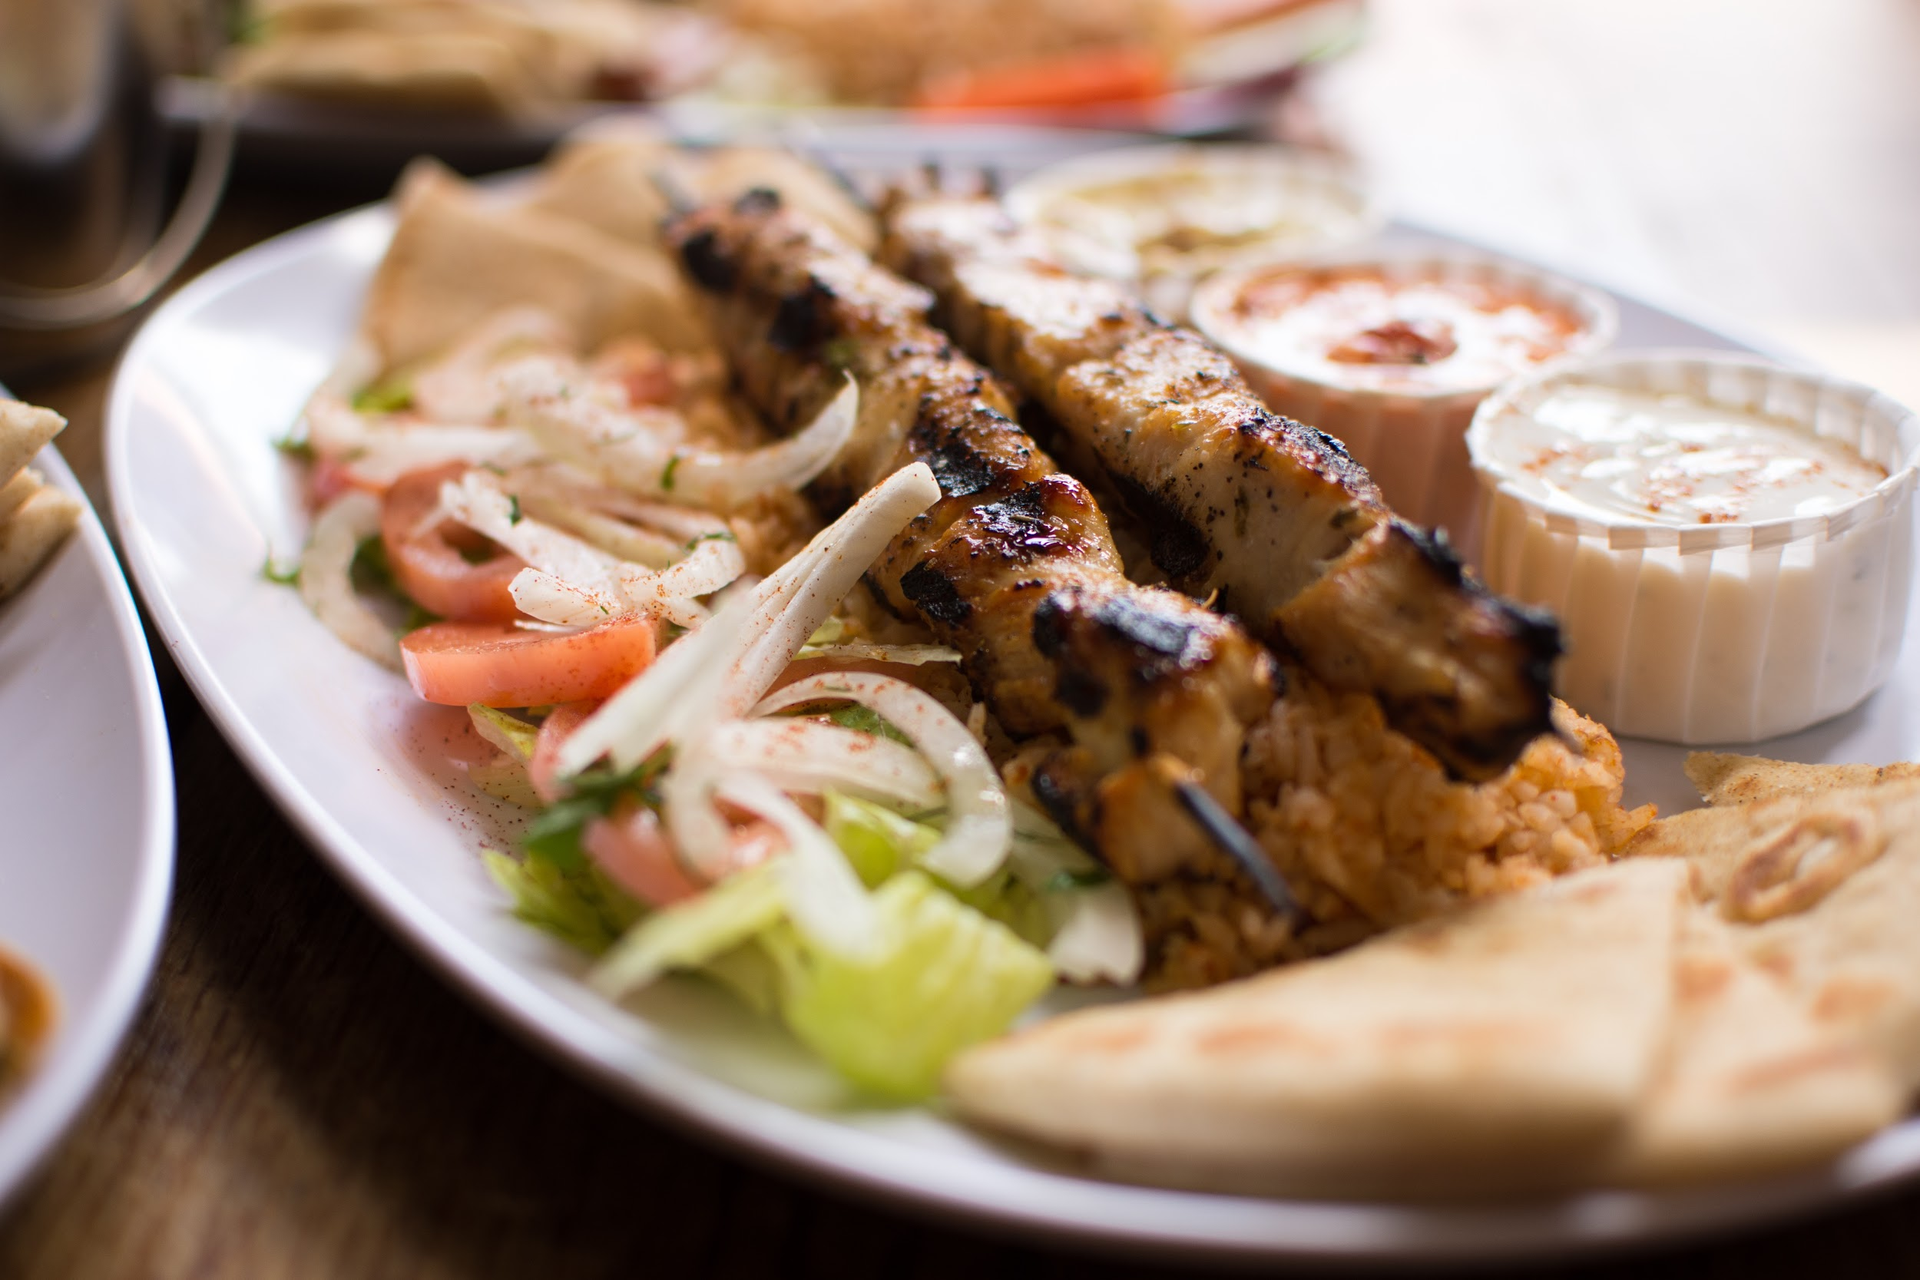
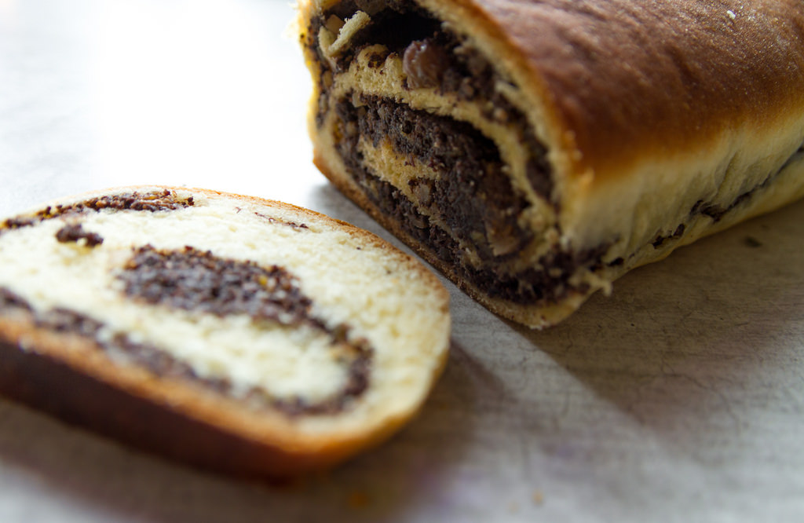
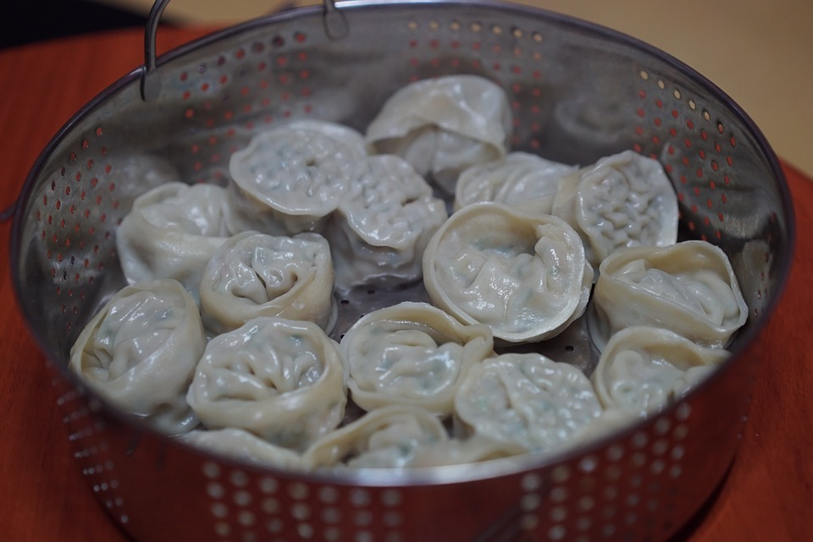
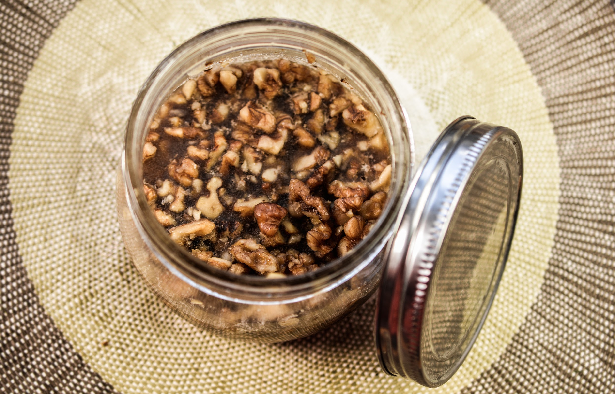
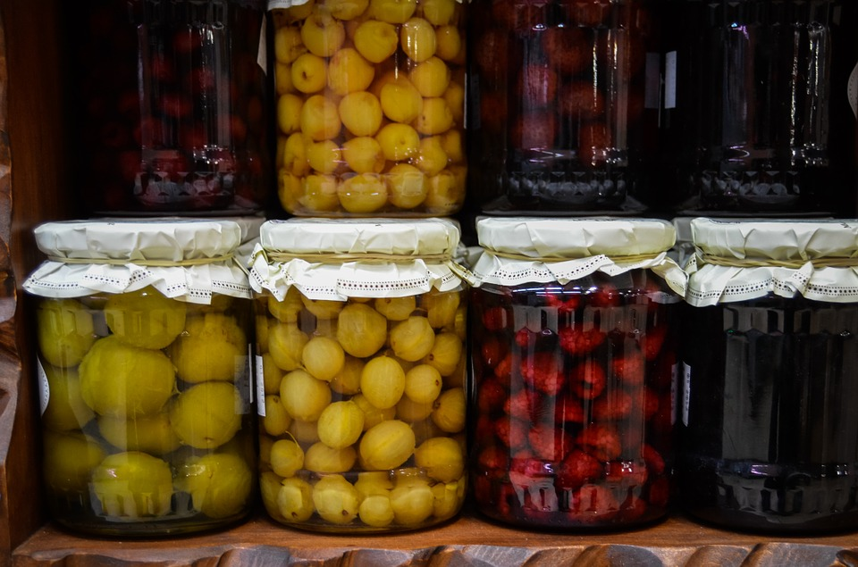
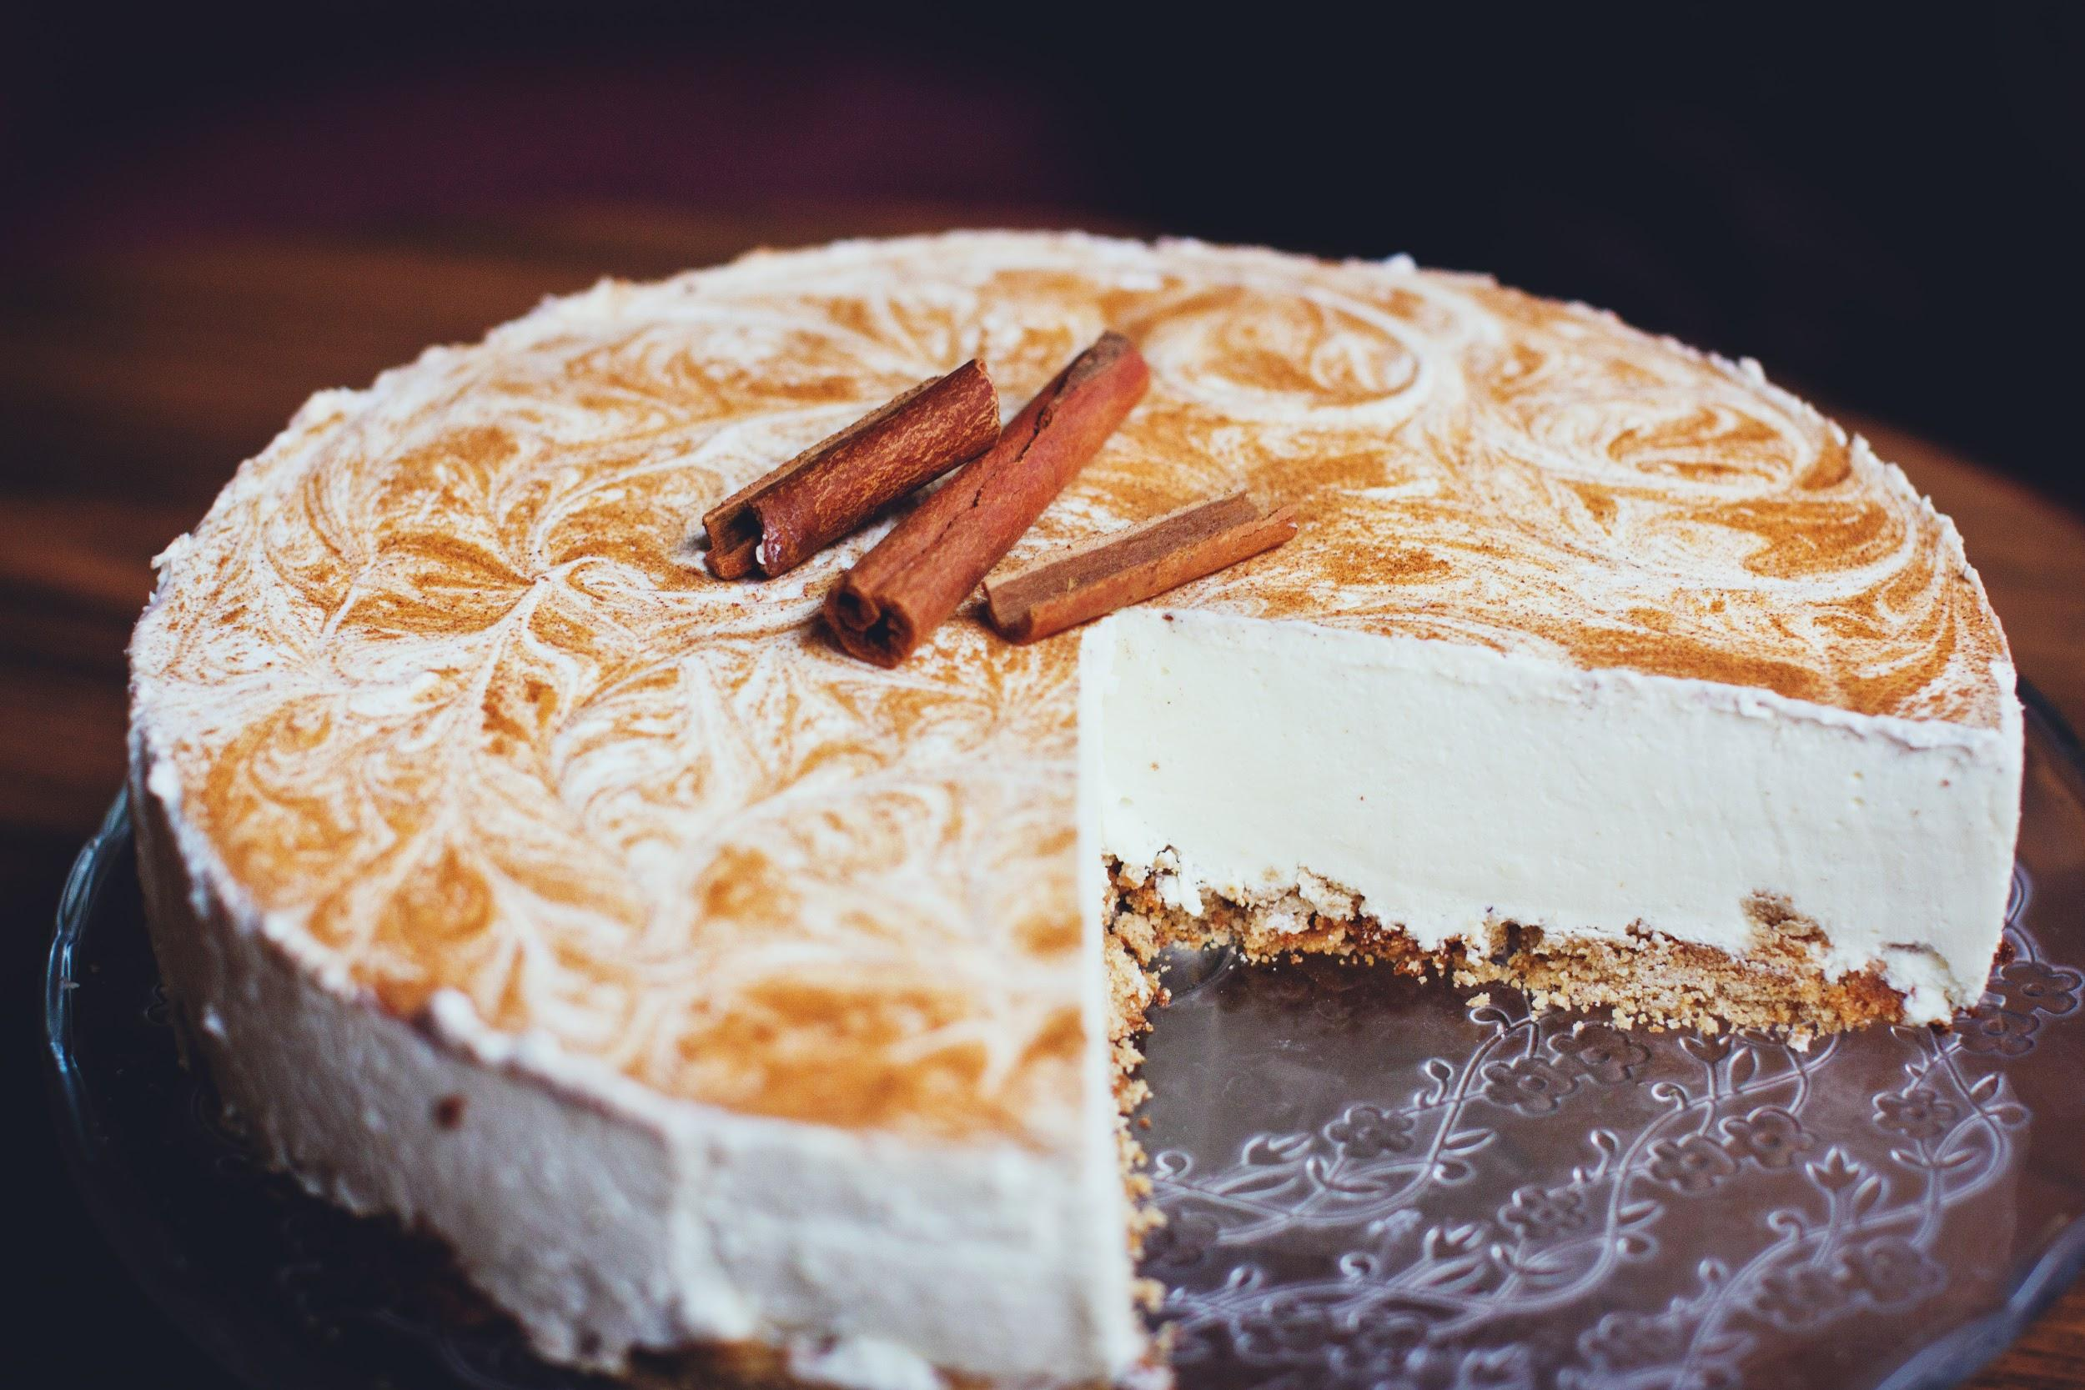
6. Fish in Greek 7. Herring, in various ways: - Herring salad - Herring in sour cream
8. Poppy seed cake 9. Noodles with poppy seeds 10. Kutia or gingerbread 11. Cheesecake 12. Dried fruit compote

Slide 11
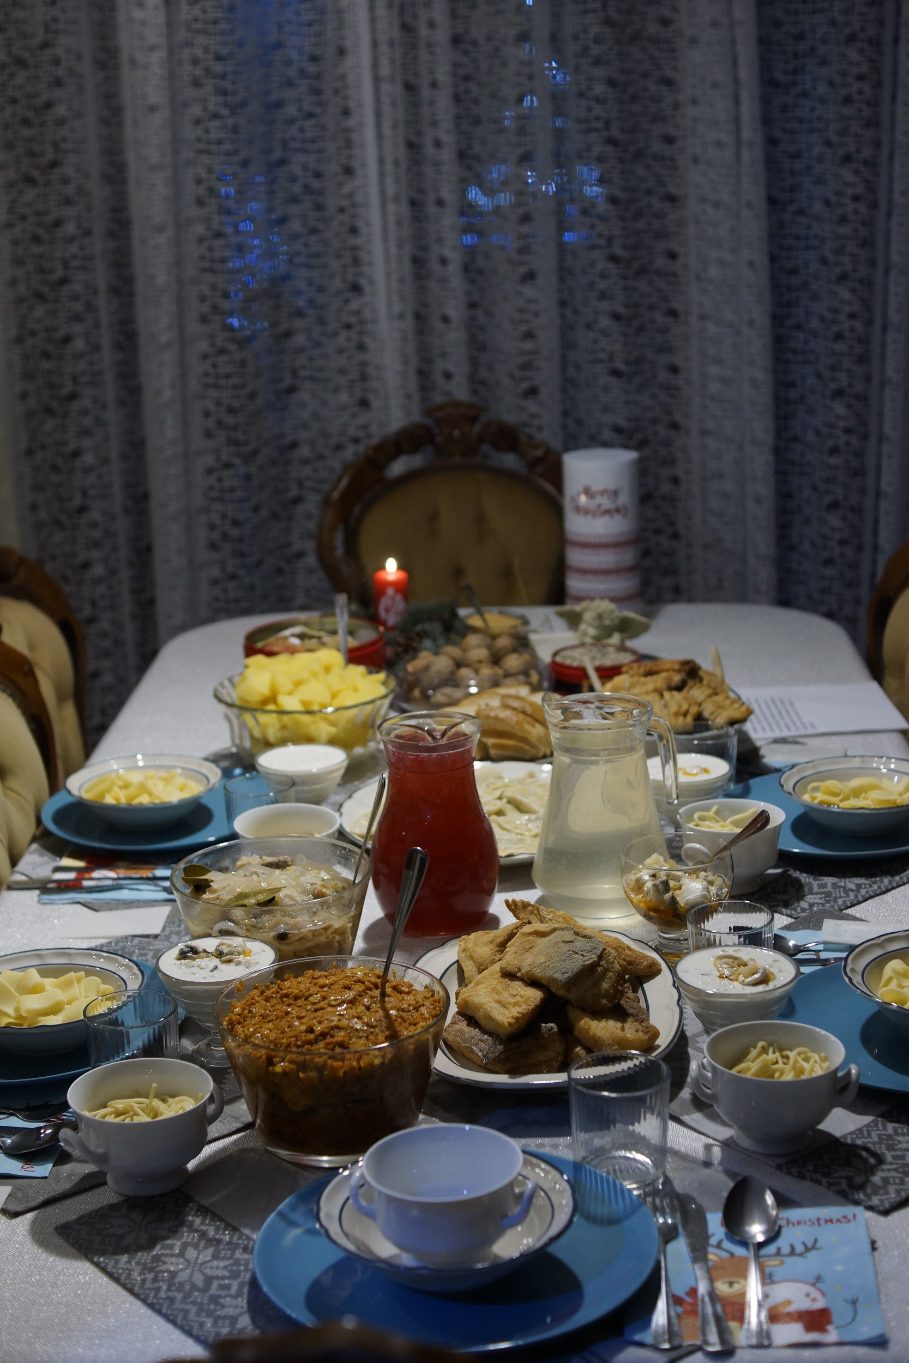
My Christmas Eve
table

